Slide 1
Verb To Be past form
Semana 17
Comunicación en Idioma Extranjero y/o Lengua

Slide 2
Temario:
Verb To Be past form
COULD (Simple past of CAN)
Affirmative- negative sentences
Questions – short answers
Simple Past (Regular Verbs)

Slide 3

1. Estimular
Could- couldnt
Modals – 'could' and 'couldn't'
We can use could and couldn't to talk about abilities in the past.
I could swim when I was four. She couldn't ride a bike when she was three. He could walk when he was two.

Slide 4
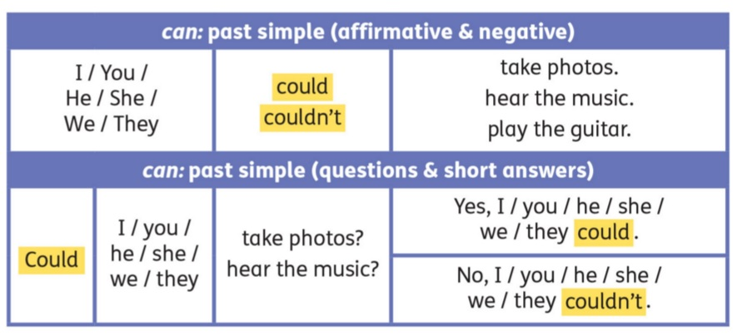
2. Explorar
Revisa el siguiente video
Enlace de: https://www.youtube.com/watch?v=UKHXEAsuELQ

Slide 5
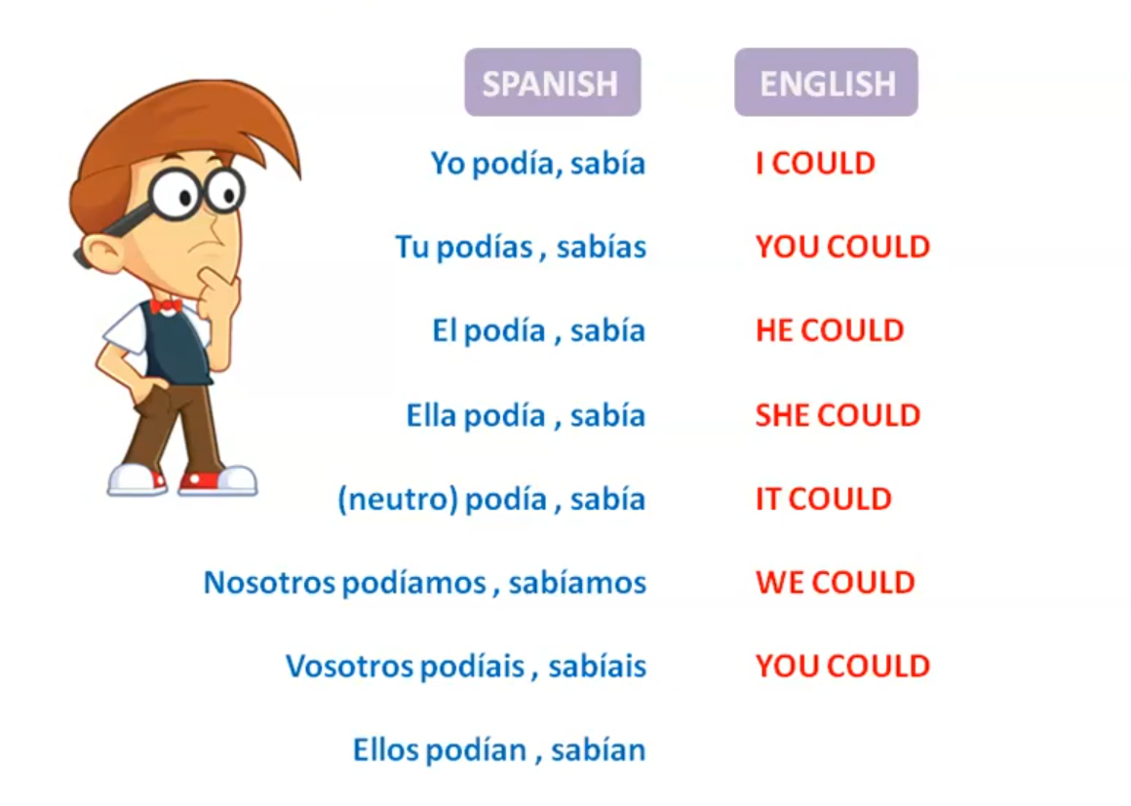
3. Entender
1. Verb “To Be” past form - Affirmative

Slide 6

Pronombre | Interrogativo
I | Could I do?
You | Could you do?
He | Could he do?
She | Could she do?
It | Could it do?
We | Could we do?
You | Could you do?
They | Could they do?

Slide 7
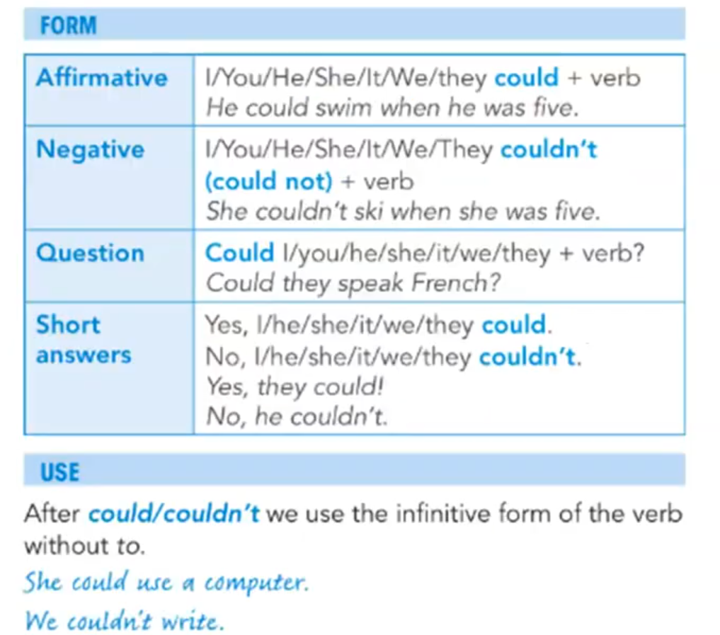
3. Entender
How to use them
Use the infinitive without to after could and couldn't.
I couldn't run when I was a baby. My mum couldn't swim when she was a child. We could read when we were five. They couldn't speak English before they went to school.

Slide 8
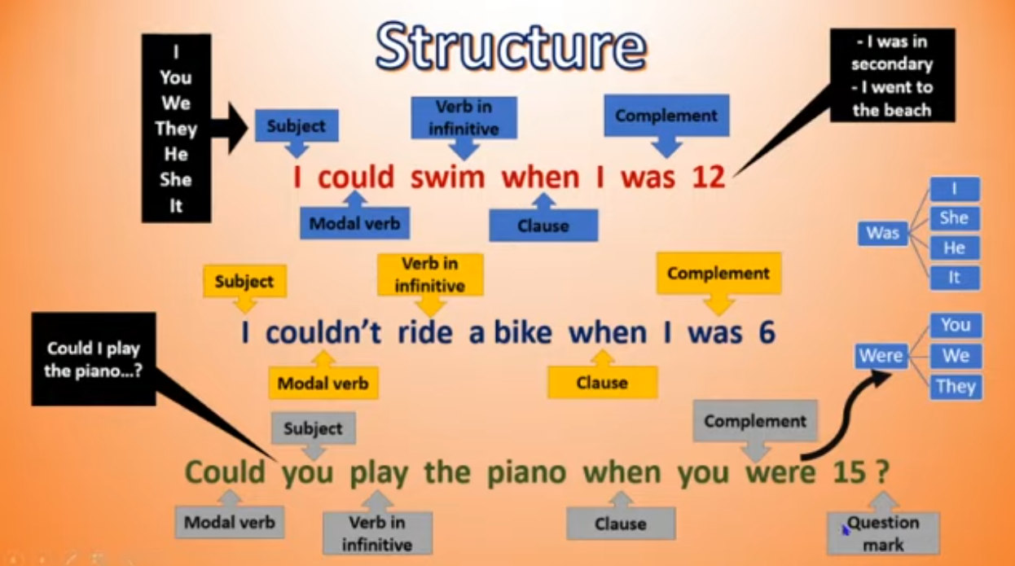
3. Entender

Slide 9
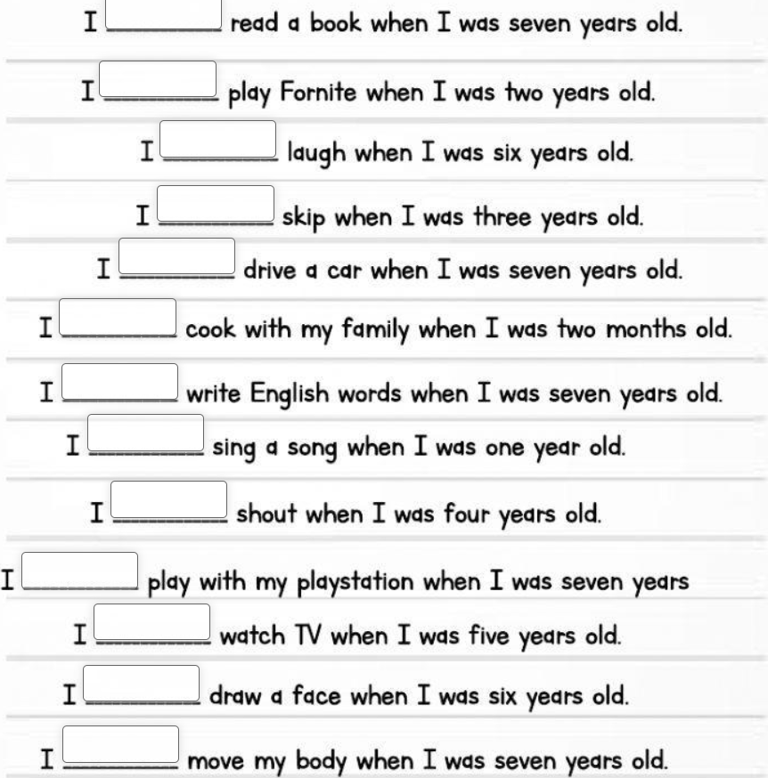
3. Entender

Slide 10
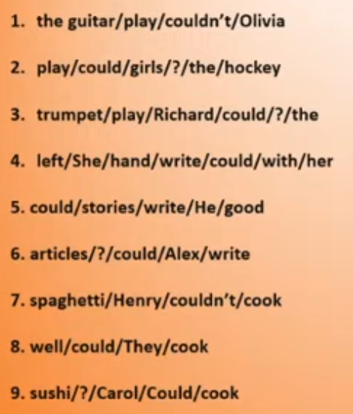
3. Entender
Olivia couldn’t play the guitar
Could the girls play hockey?
Could Richard play the trumpet?
She could write with her left hand
He could write Good stories
Could alex write articles?
Henry couldn’t cook spaghetti
They could cook well
Could carol cook sushi?

Slide 11
4. Experimentar
Revisa tu logro
¿Qué tanto consideras que has aprendido sobre verb To Be past form?
¿Qué tanto consideras que has aprendido sobre las reglas para conjugar el verbo To Be en pasado?
¿ Qué tanto consideras útiles las expresiones diarias aprendidas en clase?
Mucho
Regular
Poco

Slide 12
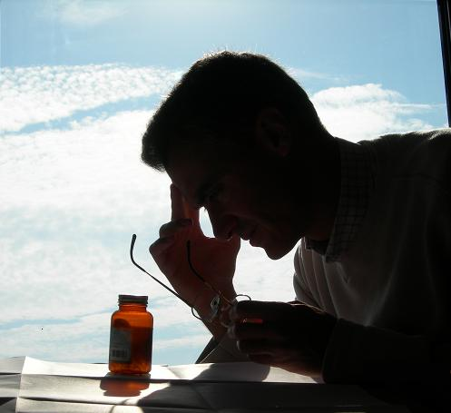
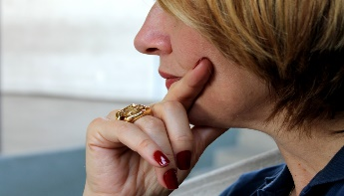

5. Evaluar
Reflexionamos
¿Qué aprendimos hoy?
¿Qué dificultades tuvimos?
¿Para qué nos sirve lo aprendido?

Slide 13

Consultas

Slide 14
Referencias bibliográficas
Algo más sobre Verb To Be past form:
https://www.grammar.cl/Past/To_Be.htm
Ejercicios sobre verb To Be past form:
https://agendaweb.org/verbs/to-be-past-exercises.html

Slide 15
Muchas gracias

